Slide 1
Investigating option pricing model
Nevina Dalal (A004)
Aanchal Gaggar(A010)
Aditya Jani (A012)
Sharvari Gokhale(A031)

Slide 2



objective
An empirical investigation of the Black Scholes call option pricing model.
To restrict errors using Bootstrap Confidence Intervals.
Improving option pricing using Artificial Neural Networks.

Slide 3
Stock Options
STOCK OPTIONS
Stock Options
Call options
European
American
Put options
European
American
Derivative Instrument
According to positions
Ability to
exercise

Slide 4

MONEYNESS
IN THE MONEY
Option's strike price is below the price of the underlying security
At the money
Option's strike price is identical to the price of the underlying security
Out the money
Option's strike price is above the price of the underlying security

Slide 5








STOCKS CHOSEN

Slide 6
DATA AND VARIABLES
1
Type of Data
Secondary Data
Stock/Year | Total number of Call options
Tata Motors | 393
SBI | 353
Reliance | 355
Tata Steel | 345
2
Period
1 Year(2018)
3
Source of Data
NSE/SBI Website
4
Call Options
1446
5
Risk free Rate
6.25%

Slide 7
Black Scholes Model
The Black Scholes model is named after Fischer Black and Myron Scholes, who developed it in 1973. Also referred to as the Black-Scholes-Merton model.
It is a model of price variation over time of financial instruments such as stocks that can be used to determine the price of a European call option.
It is regarded as one of the best ways of determining fair prices of options.

Slide 8
Assumptions
1
The asset price follows a Brownian motion with µ and σ constants.
2
There are no transaction costs or taxes. All securities are perfectly divisible.
3
There is no dividend during the life of the derivatives.
4
There are no riskless arbitrage opportunities.
5
The risk-free interest rate is constant.
6
Security trading is continuous.

Slide 9






PARAMETERS OF BLACK SCHOLES
01
Stock Price(S)
Strike Price(X)
Volatility
(σ)
Time to Expiry(t)
Risk-free Rate(r)
C=S.N(d₁)-X.e^{-rt}N(d₂)
d₁$=\frac{\ln\left(\frac{S}{X}\right)+\left(r+0.5σ^{2}\right)t}{σ\sqrt{t}}$
d₂$=\frac{\ln\left(\frac{S}{X}\right)+\left(r−0.5σ^{2}\right)t}{σ\sqrt{t}}$
Notes:
The variables are-
C = Call Price of stock option
S = Current Stock price
X = Exercise price
T = Time remaining until expiration, expressed as a percent of a year
r = Current continuously compounded risk-free interest rate
б = The instantaneous standard deviation of stock’s return.

Slide 10
BLACK SCHOLES SUMMARY
Tata Motors
t | 19
s | 0.283094
S | 424.45
R | 0.0625
K | 440
T | 0.073171
D1 | -0.37185
N(D1) | 0.355002
D2 | -0.44843
N(D2) | 0.326922
C | 7.491156
Quoted | 8.75
SBI
t | 19
s | 0.428729
S | 307.1
R | 0.0625
K | 310
T | 0.073171
D1 | 0.016375
N(D1) | 0.506532
D2 | -0.0996
N(D2) | 0.460332
C | 13.50419
Quoted | 8.85

Slide 11
BLACK SCHOLES SUMMARY
Reliance
t | 19
s | 0.22
S | 909.75
R | 0.0625
K | 940
T | 0.073171
D1 | -0.44528
N(D1) | 0.328059
D2 | -0.50453
N(D2) | 0.306946
C | 11.2393
Quoted | 17.75
Tata Steel
t | 19
s | 0.228156
S | 722.2
R | 0.0625
K | 760
T | 0.073171
D1 | -0.72167
N(D1) | 0.235249
D2 | -0.78338
N(D2) | 0.216701
C | 5.955949
Quoted | 9

Slide 12
Error Analysis
 | MSE | MAPE
Tata Motors | 3.17 | 75.35
SBI | 5.42 | 28.51
Reliance | 36.15 | 26.82
Tata steel | 7.56 | 20.62
 |  | MAPE
 | Volatility--> | 0.15-0.25 | 0.25-0.35 | 0.35 and more
Volatile | Tata motors | --- | 70.83 | 95.18
 | SBI | --- | 16.57 | 49.23
Non-Volatile | Reliance | 29.25 | 17.58 | ---
 | Tata Steel | 16.26 | 29.64 | 18.52
For Tata Motors and SBI: With increase in volatility, mispricing of the option price increases as the MAPE value can be seen increasing.
For Reliance and Tata Steel: There is no significant change in the value of MAPE.

Slide 13
ERROR ANALYSIS
 |  | MAPE
Volatility--> |  | 0.15-0.25 | 0.25-0.35 | 0.35 and more
Over-Priced(C>Q) | Tata motors | -- | 19.616 | --
 | SBI | --- | 37.489 | 63.503
 | Reliance | 29.890 | 33.105 | --
 | Tata Steel | -- | 77.302 | 35.939
Under-Priced(C<Q) | Tata motors | -- | 71.501 | 95.180
 | SBI | --- | 21.082 | 179.750
 | Reliance | 37.702 | 32.233 | -----
 | Tata Steel | 17.250 | 41.282 | 35.124

Slide 14
ARTIFICIAL NEURAL NETWORKS
01
An artificial neural network (ANN) is a computational model based on the structure and functions of biological neural networks.
They are considered nonlinear statistical data modelling tools where the complex relationships between inputs and outputs are modelled.
02
03
The network's ability to estimate closing prices is compared to the Black-Scholes model, the most widely used model for the pricing of options.
Notes:
© Copyright PresentationGo.com – The free PowerPoint template library

Slide 15

Artificial Neural Networks Parameters
S/X
PREDICTED OPTION PRICE
TIME
5 NEURONS
1 HIDDEN LAYER
σ

Slide 16


ANN for sbi
275
K
260.35
S
T
Value for one day
FOR ONE DAY
2 DAYS
σ
0.316
Q
9.35
A
9.76
Black Scholes : 5.68
MSE:
0.1681

Slide 17
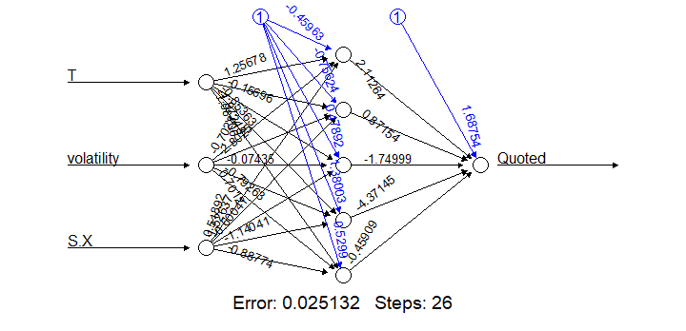
ANN FOR SBI
MEAN SQUARED ERROR:1.47596
C

Slide 18
ANN for Tata Motors
440
K
434.75
S
T
Value for one day
FOR ONE DAY
18 DAYS
FOR ONE DAY
σ
0.285
Q
21.10
A
19.637
Black Scholes 15.65
MSE:
2.14
BLACK SCHOLES:15.65

Slide 19
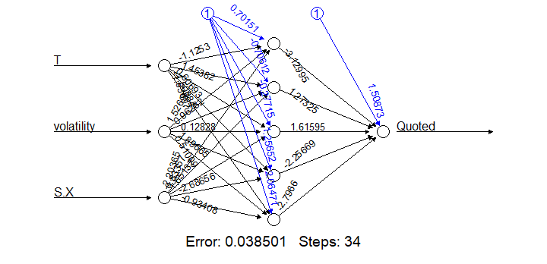
ANN for Tata Motors
MEAN SQUARED ERROR:1.9952
C
Notes:
BACK PROPORGATION ALGORITHM WITH 30% CROSS VALIDATION

Slide 20
Comparison of errors
 | MSE for 1 contract
 | Black-Scholes | ANN
Tata Motors | 10.03466 | 1.9952
SBI | 10.35019 | 1.47596
Reliance | 4.817468 | 1.02879
Tata steel | 4.033 | 1.00365

Slide 21

Hybrid Artificial neural network
ARTIFICIAL NEURAL NETWORK
MODIFIED BLACK SCHOLES

Slide 22



Modified Black Scholes
01
Black Scholes follows standard diffusion process.
f_{MB}(x)$=\frac{S}{X}$N(d₁)-N(d₂)
02
NSE uses a system of margins and deposits for short and long option positions requires a modification of standard diffusion process.
d₁$=(ln\frac{S}{X}$)+ $\frac{\frac{σ^{2}}{2}∗(T−t)}{σ∗\sqrt{T−t}}$
03
Therefore, risk free rate=0
d₂=d₁-σ$\sqrt{T−t}$
Notes:
© Copyright PresentationGo.com – The free PowerPoint template library

Slide 23
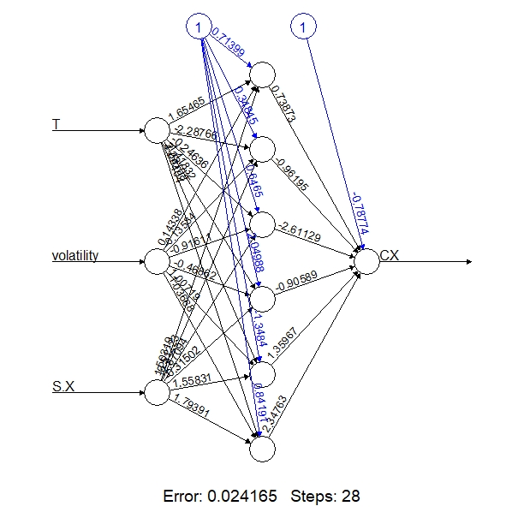
HYBRID NEURAL NETWORK FOR TATA MOTORS

Slide 24
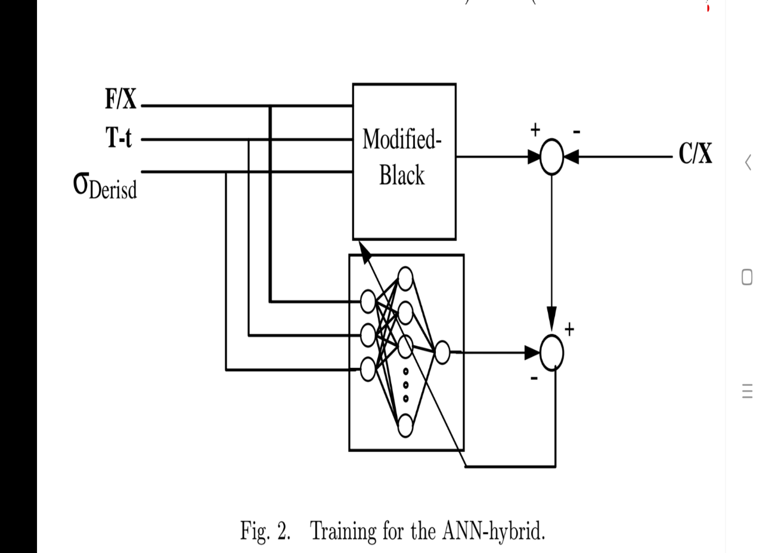
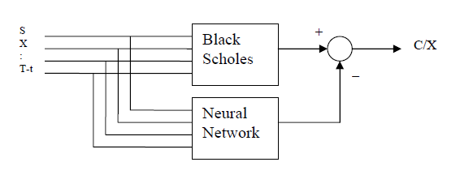
Hybrid Artificial Neural Network

Slide 25
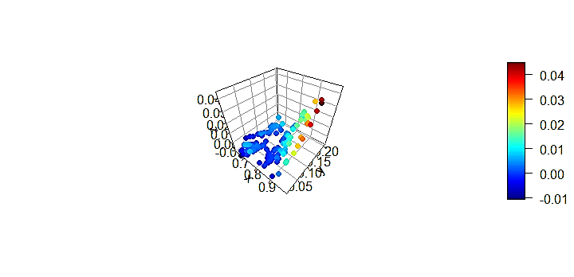
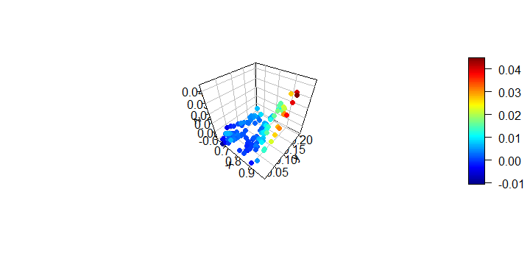
ERRORS IN HYBRID NEURAL NETWORK IN TATA MOTORS
What do the axes define?
X : Moneyness (S/X )
Y: Time to Expiry
Z: Error Term (C/X)
Notes:
As soon as the option approaches expiry the error increases

Slide 26
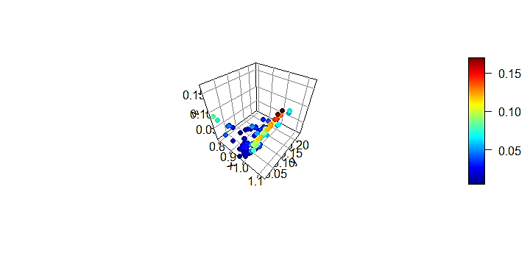
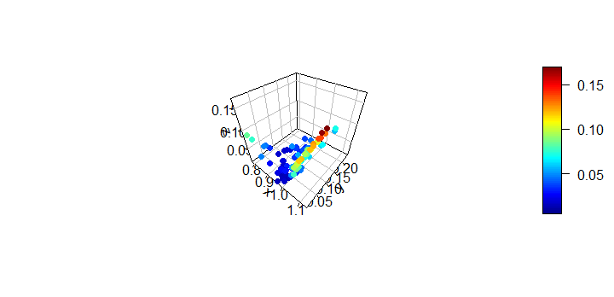
ERRORS IN HYBRID NEURAL NETWORKS IN SBI
What do the axes define?
X : Moneyness (S/X )
Y: Time to Expiry
Z: Error Term (C/X)

Slide 27

Bootstrapping
USES
Random Sampling with replacement.
Assigns measures of Accuracy to sample estimates.
Bootstrap Confidence Interval signifies the maximum and minimum possible error in option price.
Value above and below Confidence Interval signifies overvaluation and undervaluation of option pricing.
This leads to identification of option prices which are both profitable and are outside the range of model uncertainty.
Hedging strategies can be incorporated.
B
I
A
S
C
O
N
F
I
D
E
N
C
E
I
N
T
V
A
R
I
A
C
E
P
R
E
D
I
C
T
I
O
N
E
R
R
R
O
R
Prediction Error

Slide 28
Bootstrap Confidence Interval
TATA MOTORS

Slide 29
CONCLUSION
Black Scholes model misprices the call option. Mispricing worsens with increase in volatility.
Considering the errors of Black Scholes it can be concluded that there is need for some better option pricing model.
Artificial neural network performed is found to outperform Black Scholes option pricing model.

Slide 30
LIMITATIONS AND FUTURE SCOPE
All the type of options can be taken into consideration for better analysis and accurate results
Longer duration and more stocks can be included
A proper option trading strategy can be developed through bootstrap confidence interval which may led to profitable trades through Hedging

Slide 31
ACKNOWLEDGEMENT
We would like to extend our thanks to Dr. M. Raghunath and Miss. Ashita Dara for their guidance and constant support.
Special thanks to Mr. Jagabandhu Padhy

Slide 32
THANK YOU

